Slide 1
DSI Project 3 Regression and Classification Renovate your basement
By Alex Yi Zhou

Slide 2
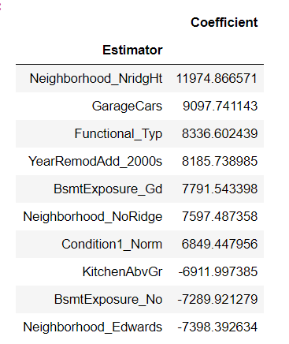
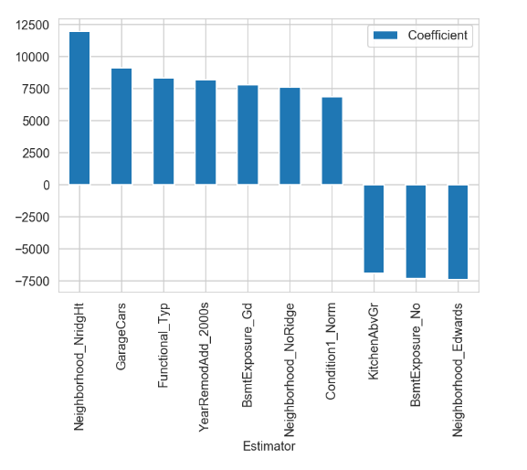
Coefficients

Slide 3
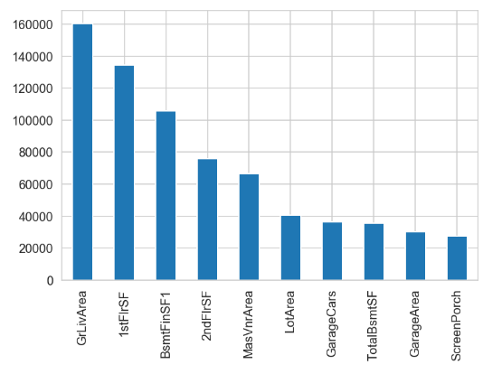
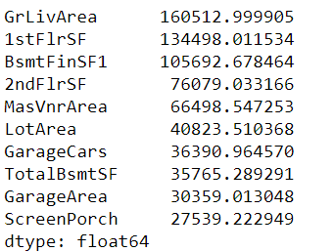
Coefficients * Actual Data (highest values)

Slide 4

Coefficients * Actual Data (lowest values)
People want to sleep in the basement

Slide 5

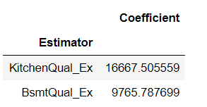
Evaluate the residuals

Slide 6
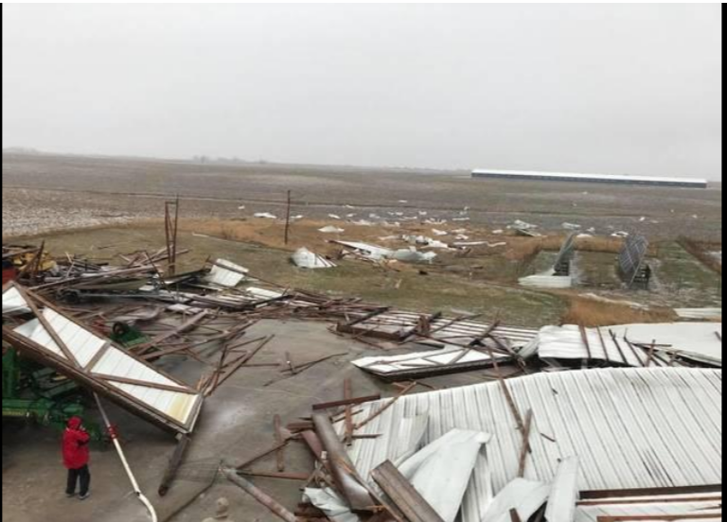
Ames people love nice basements

Slide 7
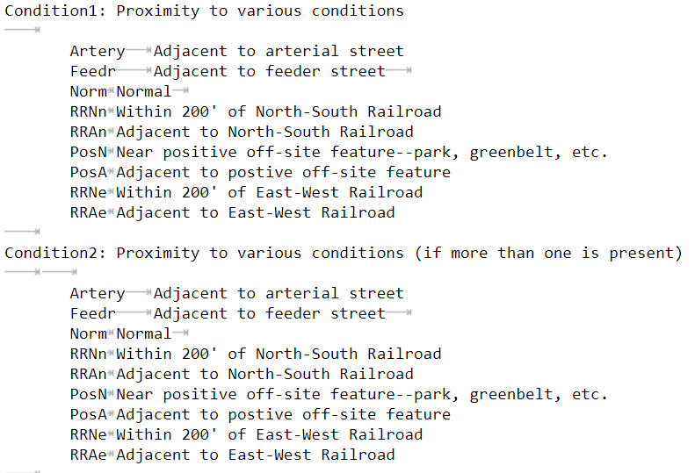
Read carefully before filtering

Slide 8
Thank you for listening

